Slide 1
Battle of Investment Justice: Protecting Your Foreign Investment.
An overview of investment protection treaties and how to commence an arbitration proceeding against a government with the International Center of Investment and Settlement Dispute.

Slide 2
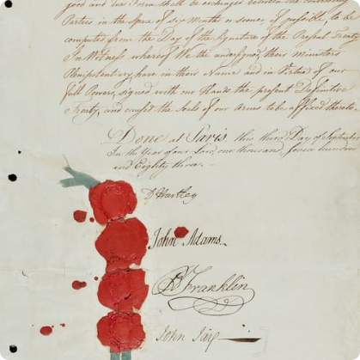
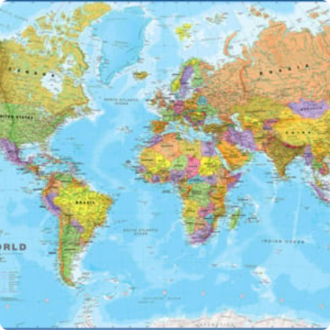
Investment Treaties and Their Role
Definition
The role of Investment Treaties
Benefits of Investment Treaties
Conclusion
Investment treaties are formal agreements between countries to promote and protect foreign investment.
These treaties set out the conditions and safeguards under which foreign investors can invest in a host country.
They provide certainty, stability, and protection to investors in a globalized market.
Investment treaties play a vital role in protecting foreign investment from the risks and uncertainties of doing business abroad.

Slide 3
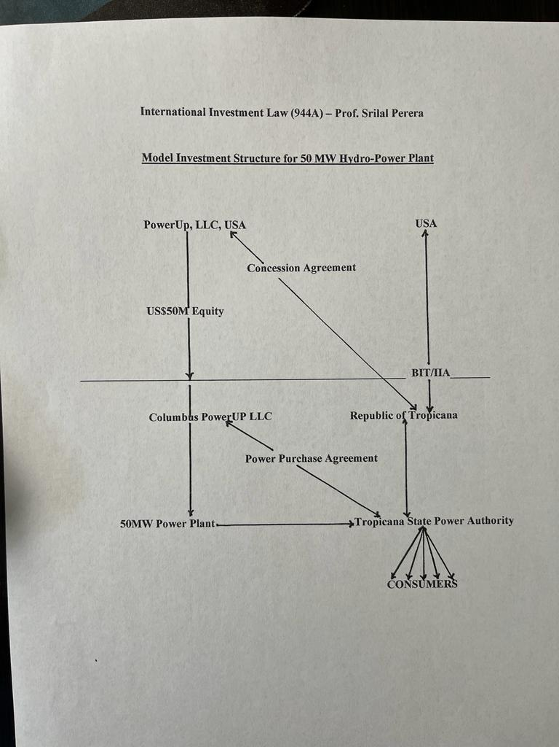

Slide 4
Investment Disputes with Governments
1
What are investment disputes?
2
The challenges of investment disputes
They arise when a government takes measures that negatively affect the investments of foreign investors.
Disputes can be complex, difficult to navigate, and can involve significant costs for the parties involved.
3
Reaching an agreement with a government
4
Conclusion
Dealing with investment disputes requires patience, strategic thinking, and a deep understanding of the legal frameworks involved.
It is always preferable to find a negotiated solution to an investment dispute before resorting to arbitration.

Slide 5
Current Investment Disputes
Jurisdiction
Proper Nationality (Claimant), State Responsibility (State as Respondent)
Subject matter: Is there an investment? Expropriation or Breach of Contract
Prescription Periods
Proper situs.
Merits
Fair and Equitable Treatment clause
Breach of Contract
Expropriation
Compensation and compensation standards
Enforcement of Arbitral Awards With The New York Convention

Slide 6
International Center of Investment and Settlement Dispute
What is ICSID?
Why choose ICSID?
How does ICSID work?
The International Center for Settlement of Investment Disputes is an institution established by the World Bank to facilitate investment dispute resolution.
ICSID provides a neutral, efficient, and cost-effective forum for resolving investment disputes between investors and states.
An ICSID tribunal is composed of three arbitrators selected by the parties. The tribunal's award is final and binding.
Conclusion
ICSID has played a critical role in the development of international investment law and continues to be an essential institution in protecting the rights of foreign investors.

Slide 7
ICSID Expedited Rules and Rules on Mediation
ICSID Expedited Rules of Arbitration
ICSID Rules on Mediation
Conclusion
The ICSID rules on mediation allow parties to a dispute to pursue a facilitated negotiation process with the assistance of a neutral third-party mediator.
The ICSID expedited rules and mediation rules provide valuable tools to investors for resolving disputes effectively and efficiently.
The ICSID Expedited Rules provide for a simplified, faster, and less expensive arbitration process for claims that meet certain criteria.

Slide 8
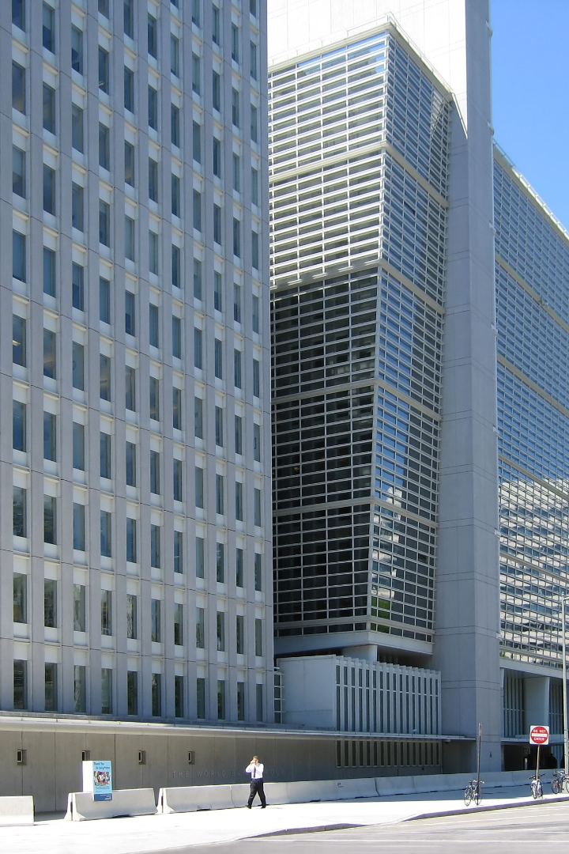
Multilateral Investment Guarantee Agency (MIGA)
The Multilateral Investment Guarantee Agency (MIGA) is a member of the World Bank Group that provides insurance against political risks such as expropriation, breach of contract, and war or civil disturbance. MIGA works to promote foreign direct investment into developing countries to help support economic growth and reduce poverty.

Slide 9
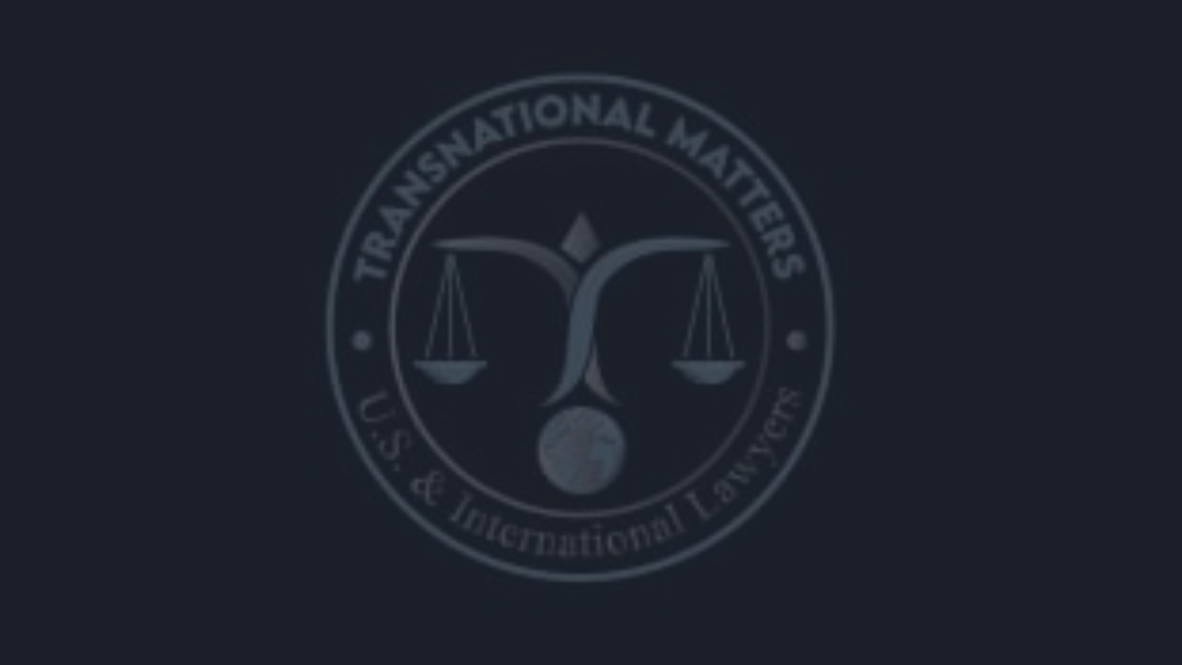
Conclusion: Protect Your Investment with Transnational Matters PLLC
Investments are critical to the growth and development of any business, and protecting them is of utmost importance. Transnational Matters PLLC has experienced attorneys who specialize in foreign investment disputes. Our attorneys can assist you in every step of the process, from negotiating treaties to calculating damages. Let us help you protect your investments and safeguard your future.

